Slide 1
Unraveling Cellular Complexity
Insights from Single-Cell Gene Expression Analysis
Team Lead: Shaolei Ma
Members: Peng Su; Yilei Yang; Zhuodiao Kuang

Slide 2
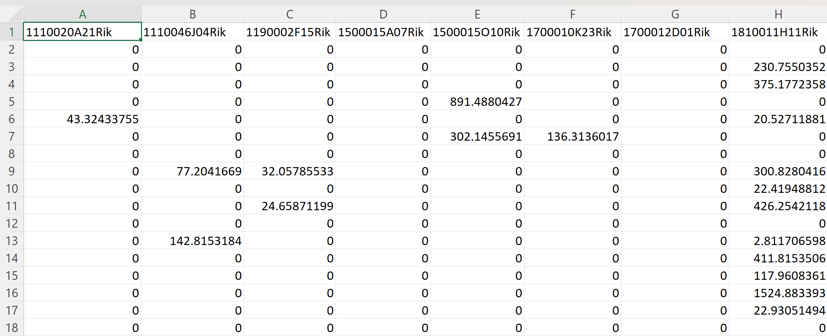
Data Overview
Dataset Composition:
716 cells
Analysis of 558 genes per cell.

Slide 3
Introduction
Gaussian-Mixture model
EM algorithm
Principal Component Analysis
Raw Data
Clusters
Explore gene-expression signatures in each of Clusters
Which genes are important to differentiate the clusters?

Slide 4
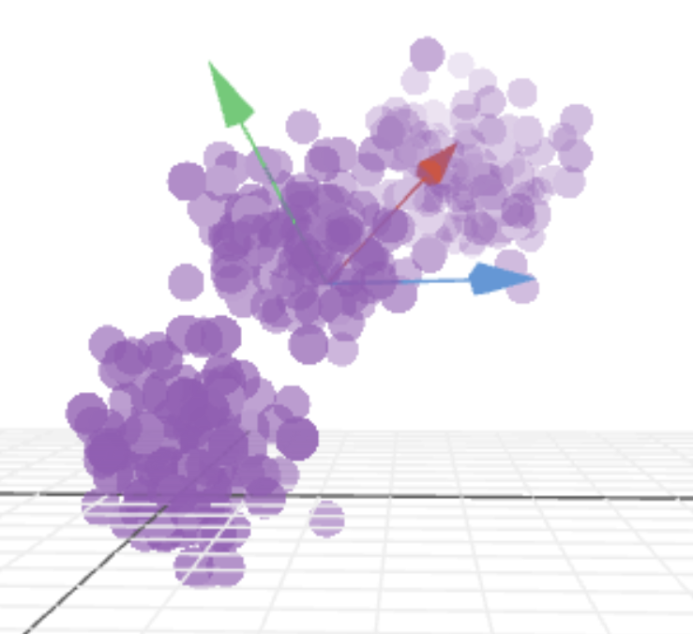
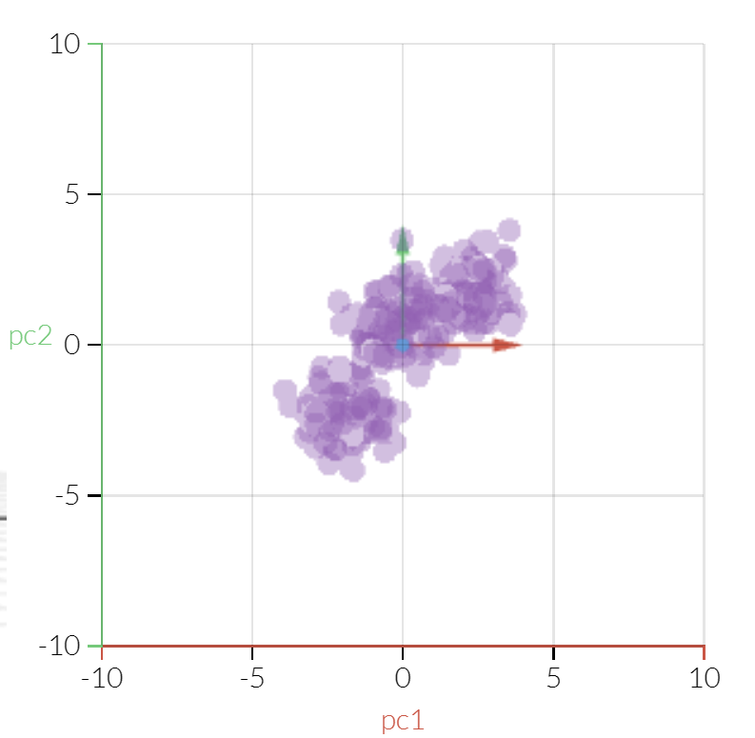
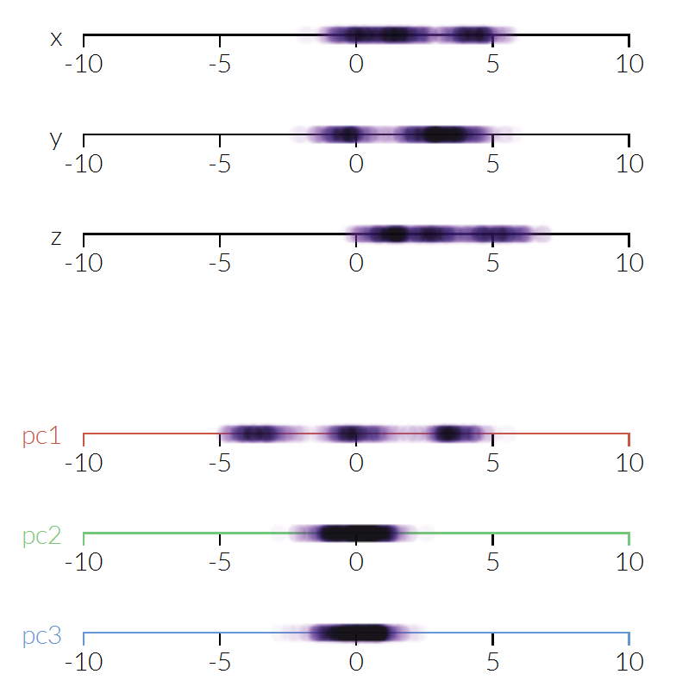
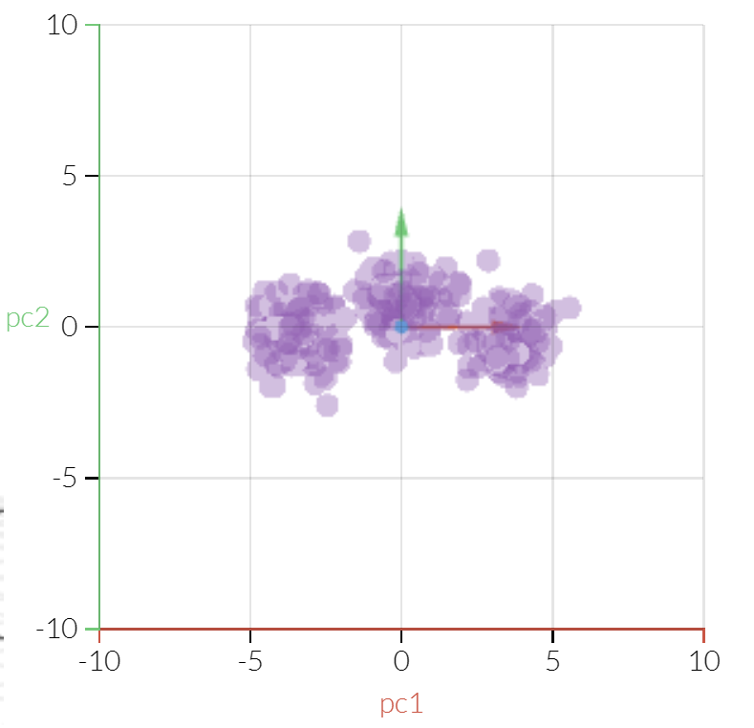
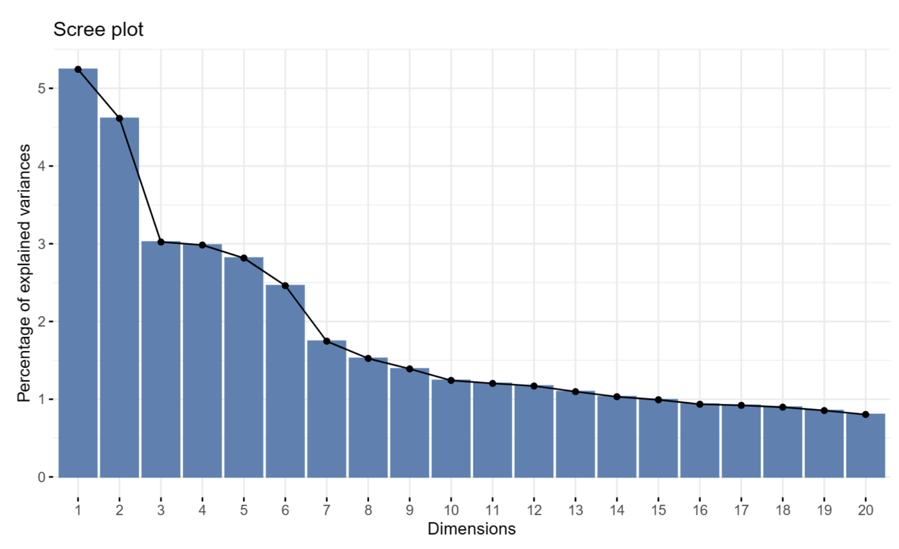
Principal Component Analysis (PCA)
Objective:
Capture major variability in gene expressions.
Methodology:
Using `prcomp` from R.
Outcome:
Selected principal components: 3, 7, 10 based on the scree plot.
Source:
https://setosa.io/ev/principal-component-analysis/

Slide 5
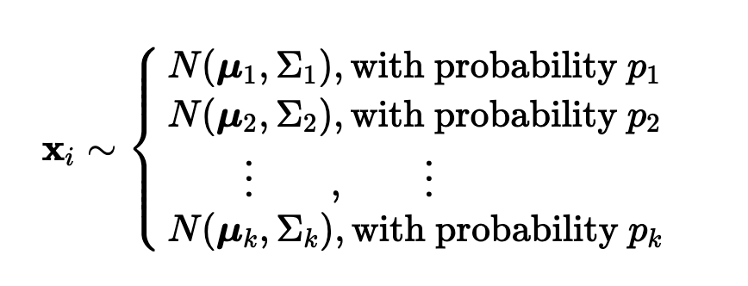
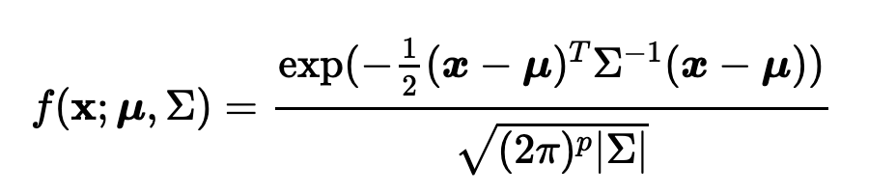
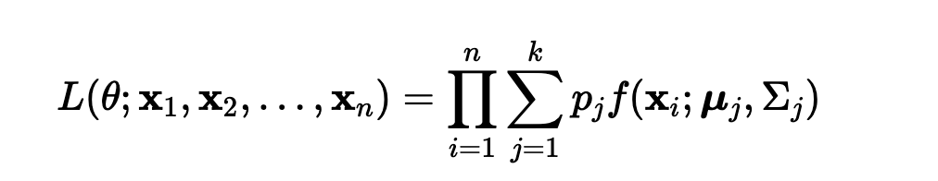
Gaussian Mixture Model
A way of clustering
Assumption: there are a certain number of Gaussian distributions, and each of these distributions represent a cluster.
5

Slide 6
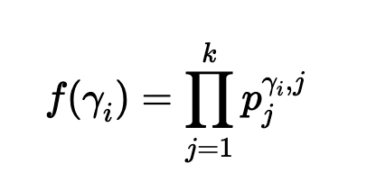
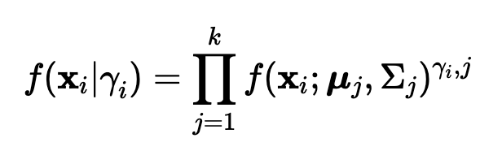
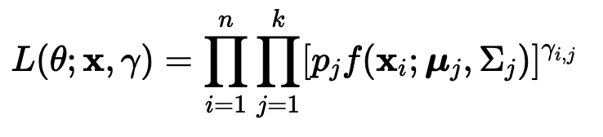
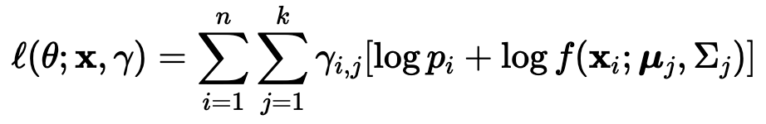
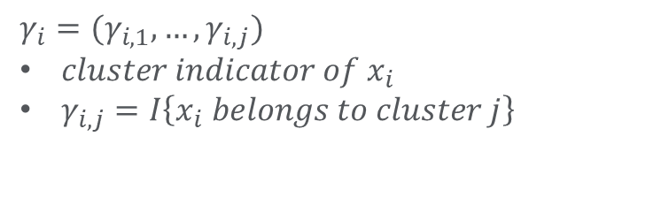
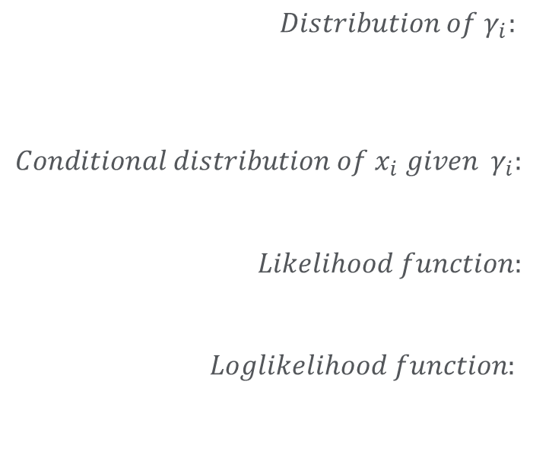
Gaussian Mixture Model
$$γ_{i}=(γ_{i, 1}, …, γ_{i,j})$$
$cluster indicator of x_{i}$
$γ_{i, j}=I\left\{x_{i} belongs to cluster j\right\}$
$$Distribution of γ_{i}:$$
$$Conditional distribution of x_{i} given γ_{i}:$$
$$Likelihood function:$$
$$Loglikelihood function:$$
6

Slide 7
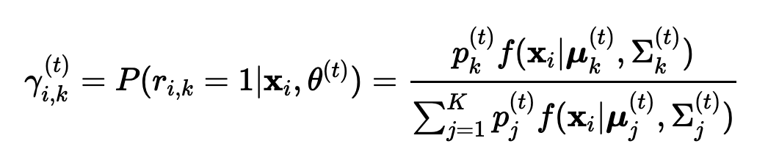
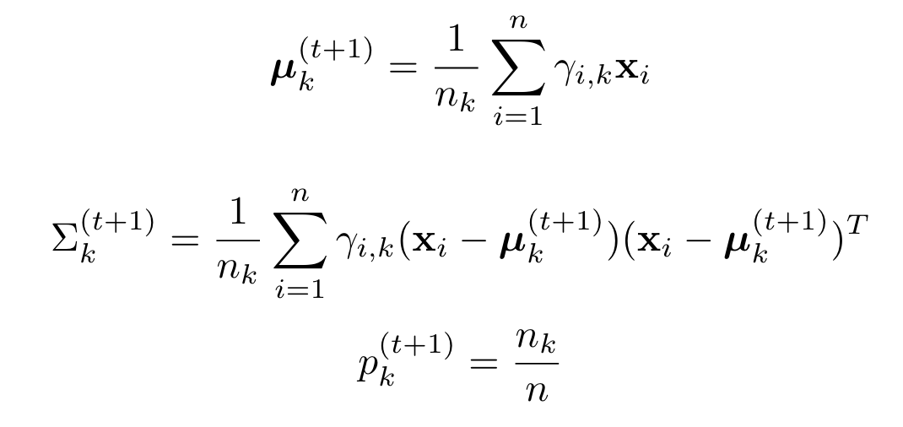
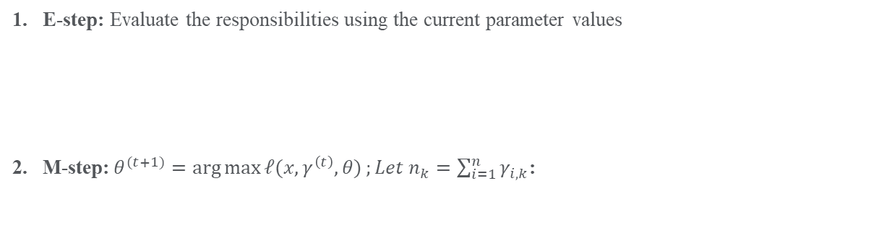
E-M Algorithm
E-step: Evaluate the responsibilities using the current parameter values
2. M-step:${θ^{(t+1)}=\arg{\max{ℓ(x, γ^{\left(t\right)}, θ)}};Let n}_{k}=\sum_{i=1}^{n}{γ_{i,k}}$:
7

Slide 8
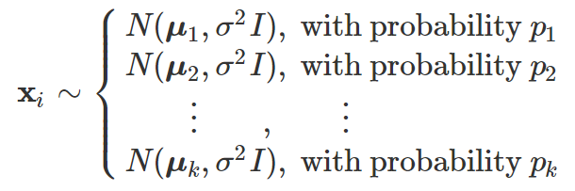
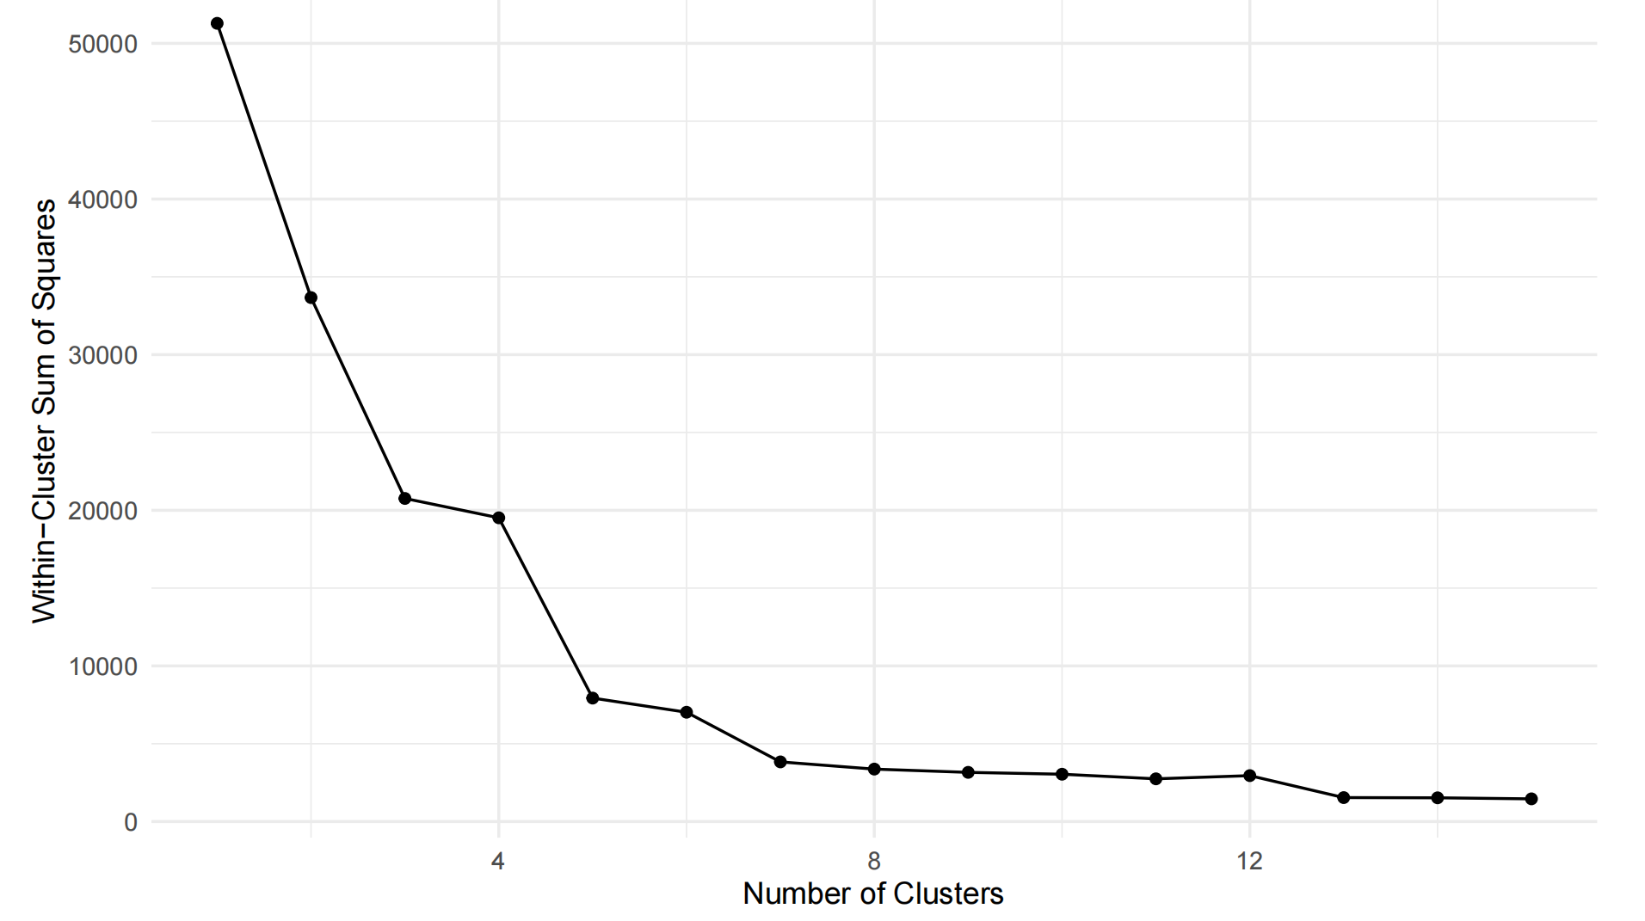
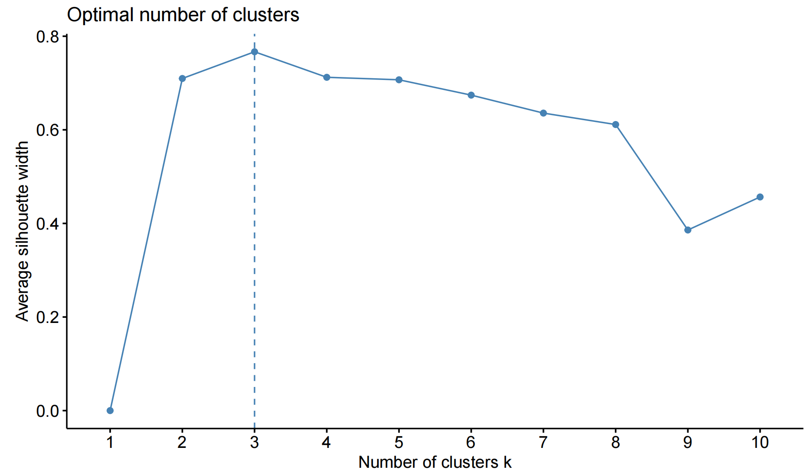
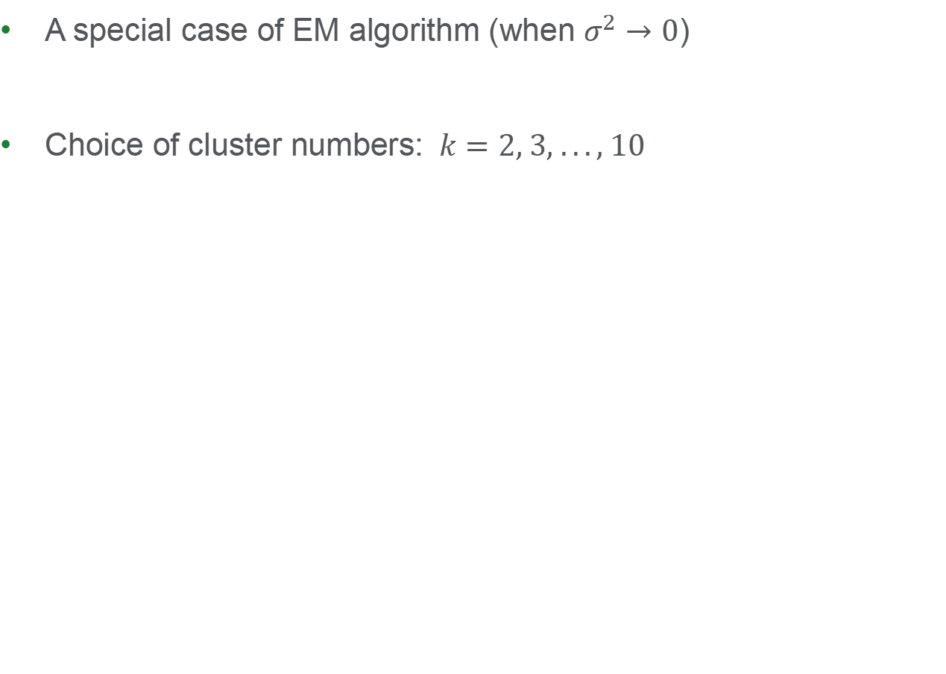
K-Means
A special case of EM algorithm (when $σ^{2}→0$)
Choice of cluster numbers: $k=2, 3, ..., 10$

Slide 9
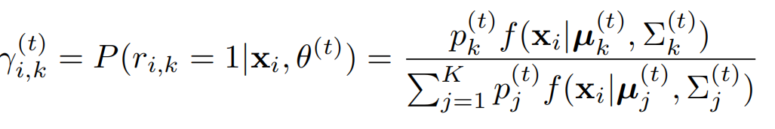
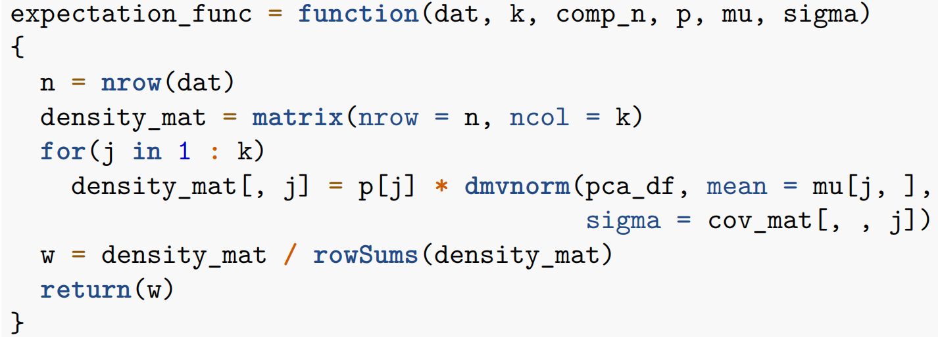
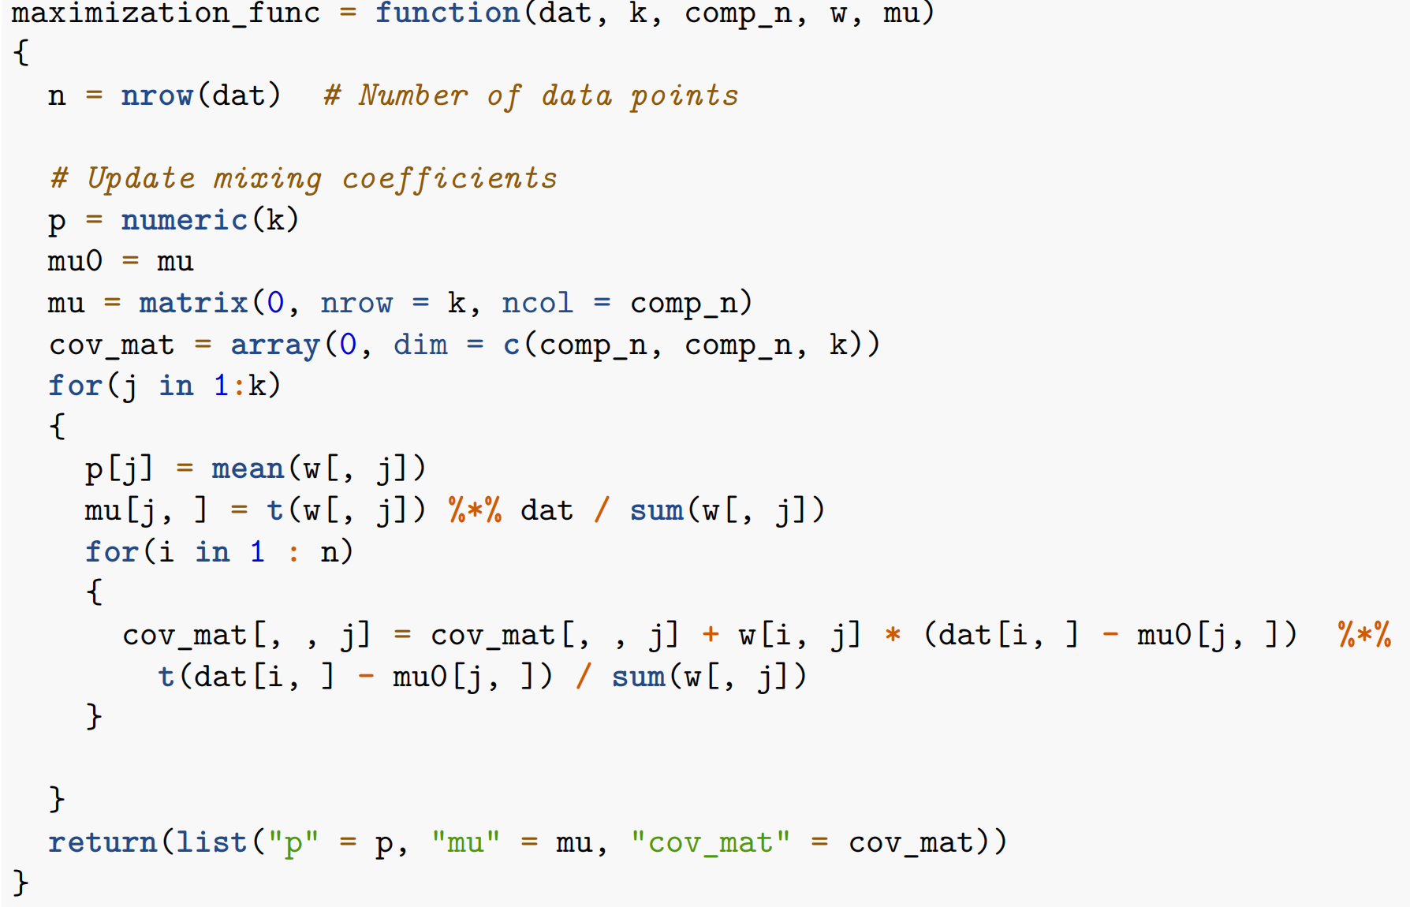
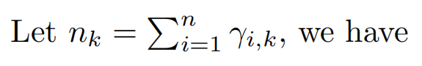
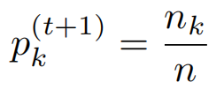
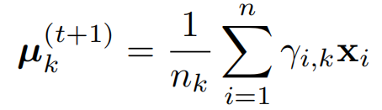
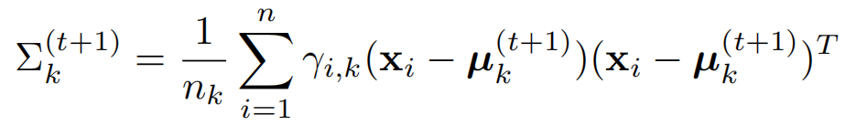
EM Algorithm Implementation
Expectation Step:
Maximization Step:

Slide 10
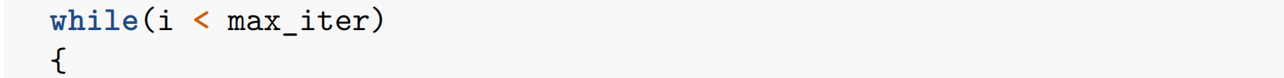
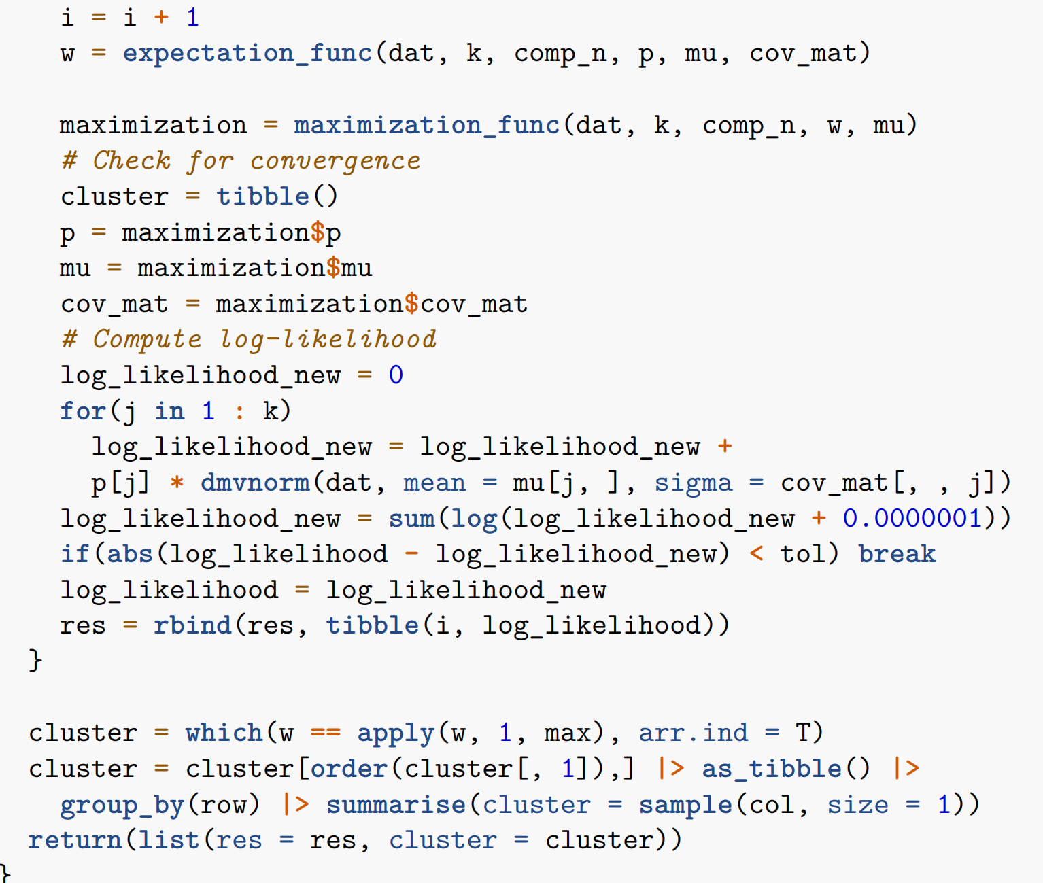
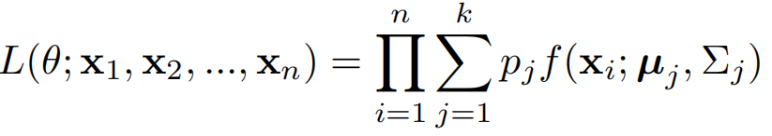
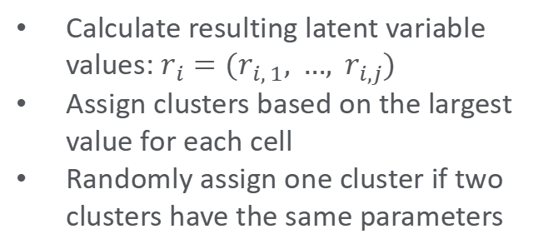
EM Algorithm Implementation
E-M Iteration:
E-M Iteration
Compute marginal likelihood
End process when difference between two iterations < tolerance
Calculate resulting latent variable values: $r_{i}=(r_{i, 1}, …, r_{i,j})$
Assign clusters based on the largest value for each cell
Randomly assign one cluster if two clusters have the same parameters

Slide 11
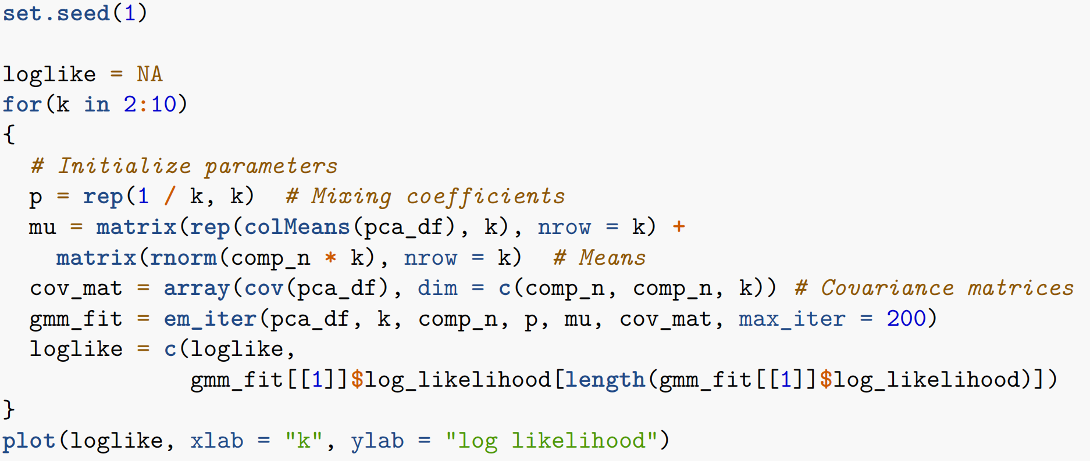
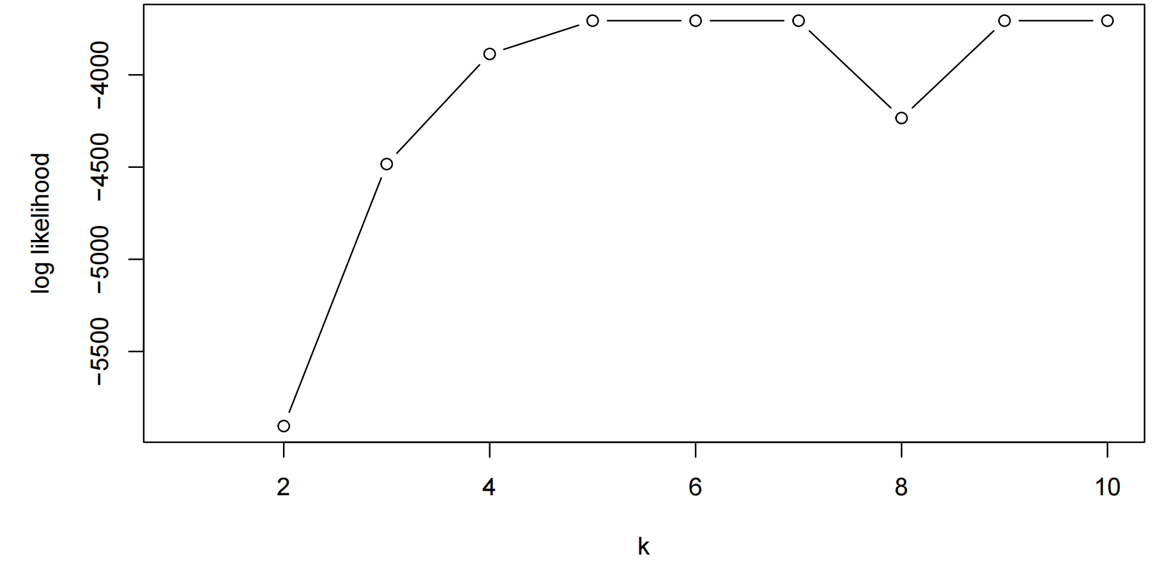
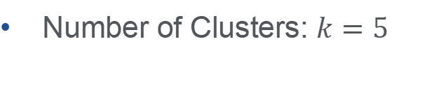
Cluster Number Selection
Parameter Initialization:
mean & covariance of the PCA results + a random component
Number of Clusters: $k=5$

Slide 12
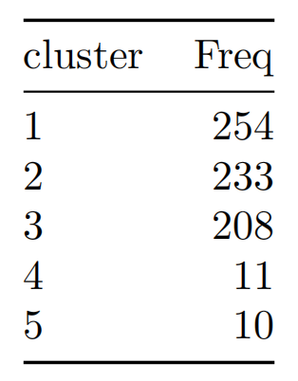
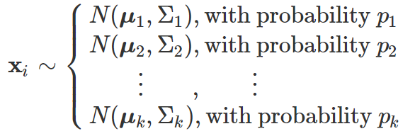
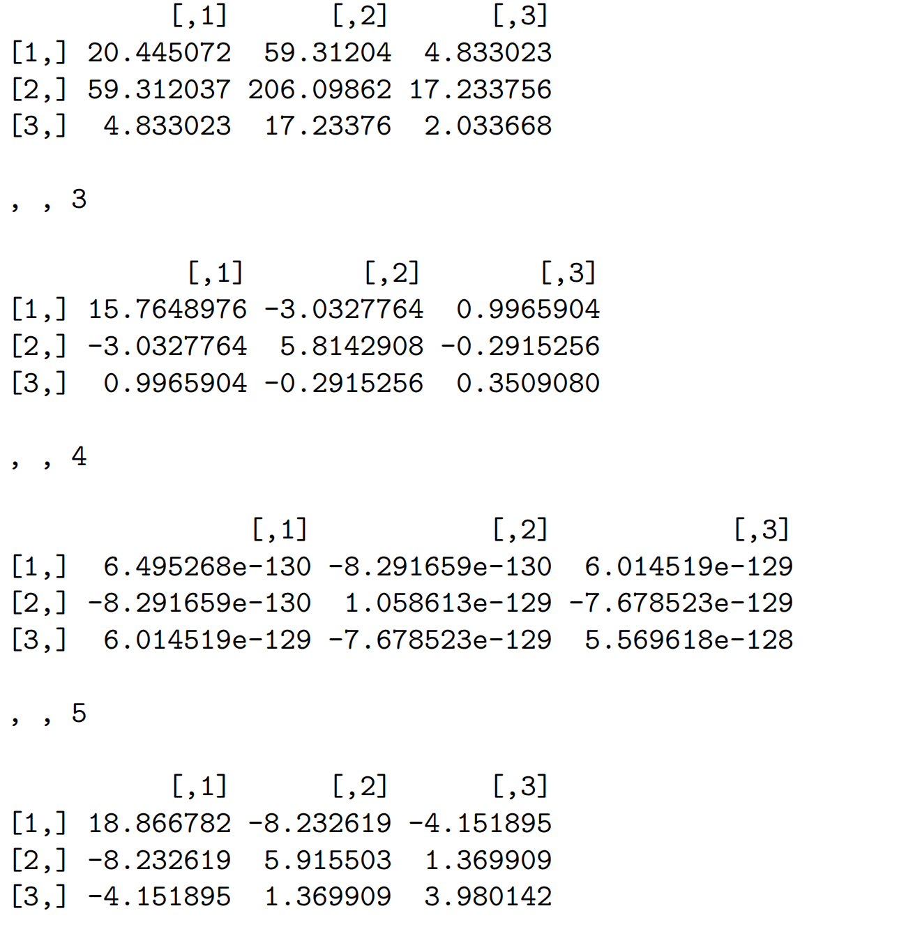
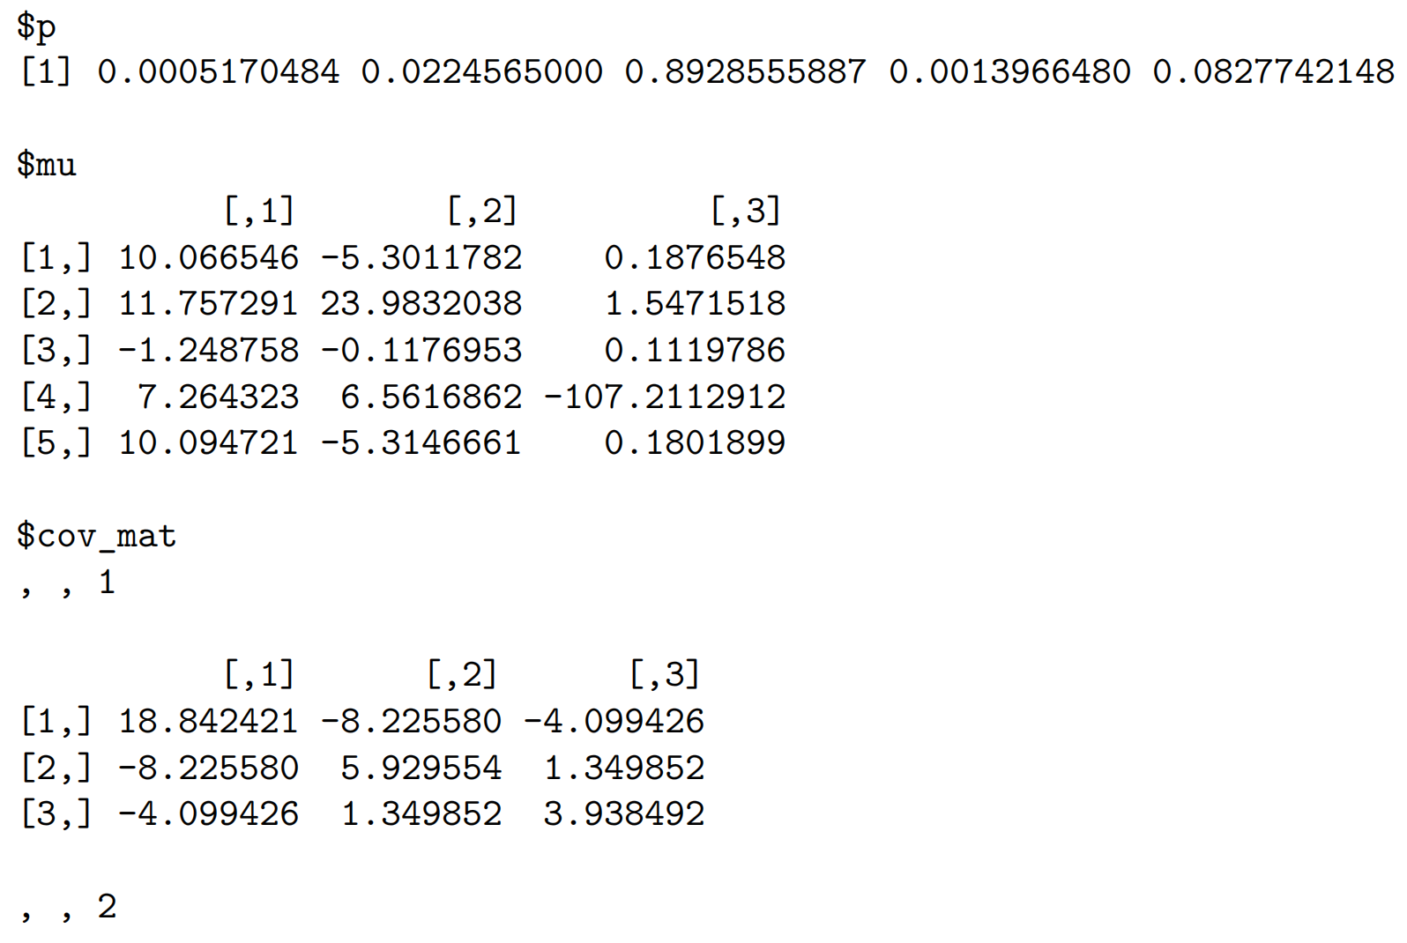
Clustering Results
Cluster Assignments:
Parameters:

Slide 13
Significantly Differential Expressed Genes —— Method
Differential Gene Expression analysis
Data Transformation and weights estimation
log 2 transformed and normalized
precision weights estimation
Linear model fitting and updating
Fit linear model for each gene
model updated by integrating group comparison information
Improvements in statistical testing
Empirical Bayes: to refine the statistical inference
Define DEGs and combind results
|log FC| > 2, p value < 0.01
significantly differential expressed in 2 comparison
13

Slide 14
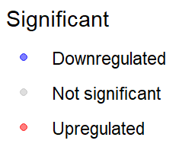
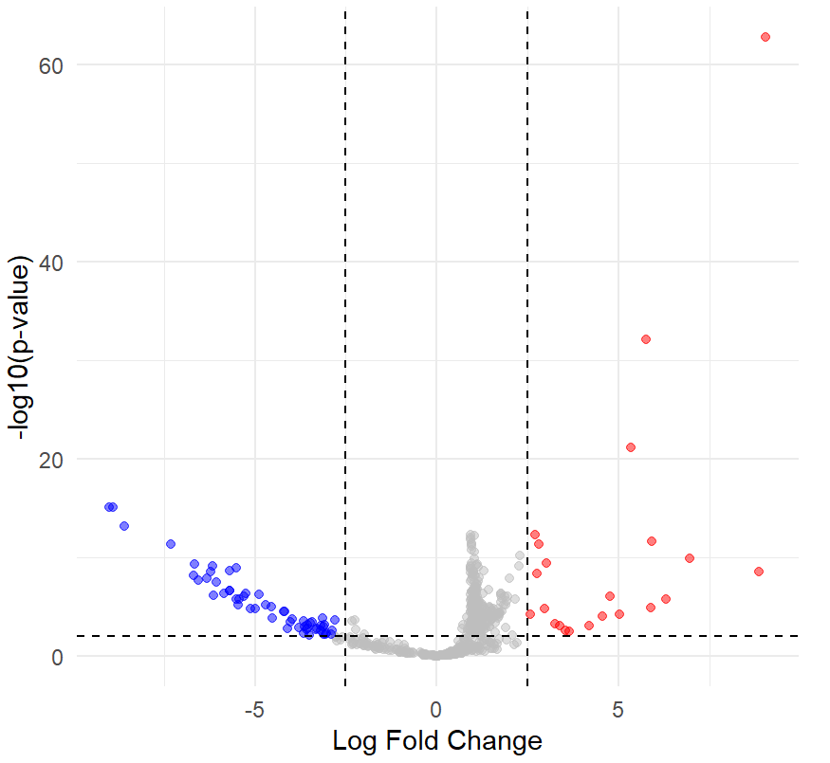
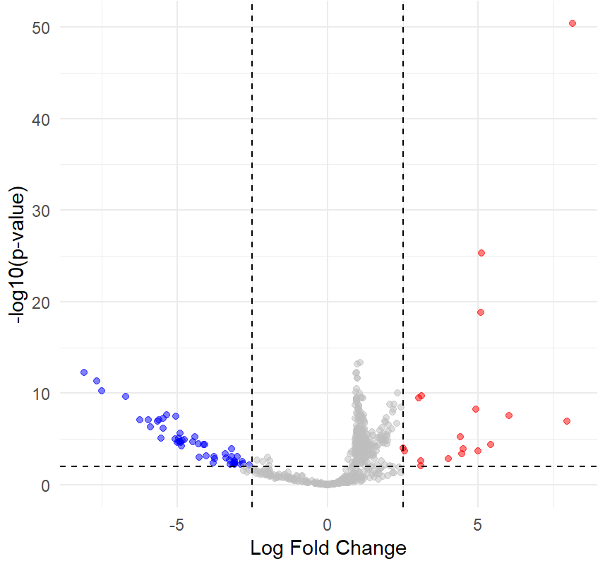
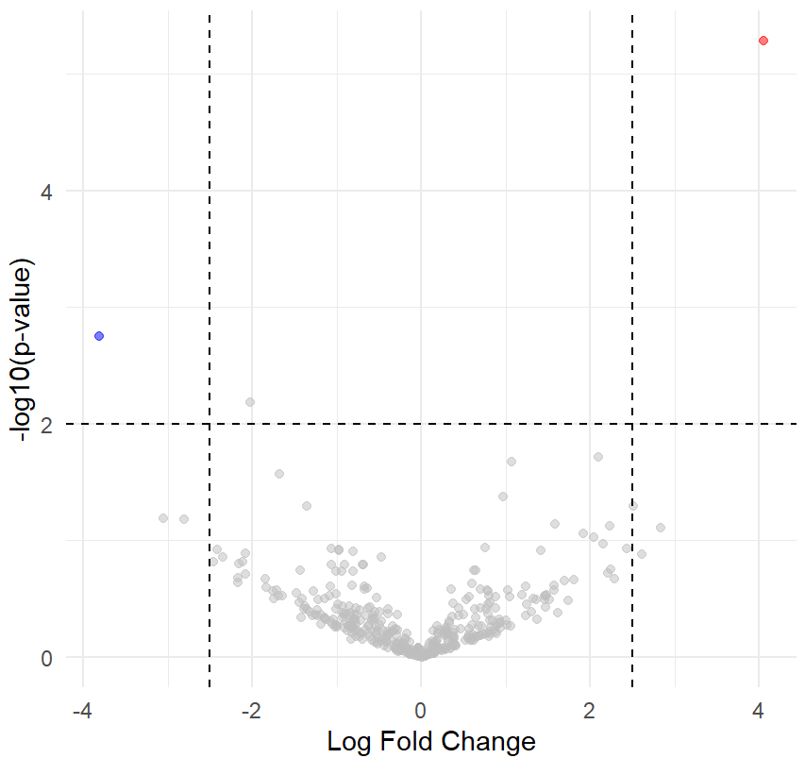
Significantly Differential Expressed Genes —— Results
A
B
C
Cluster 1 VS 4
Cluster 2 VS 4
Cluster 4 VS 5
14

Slide 15
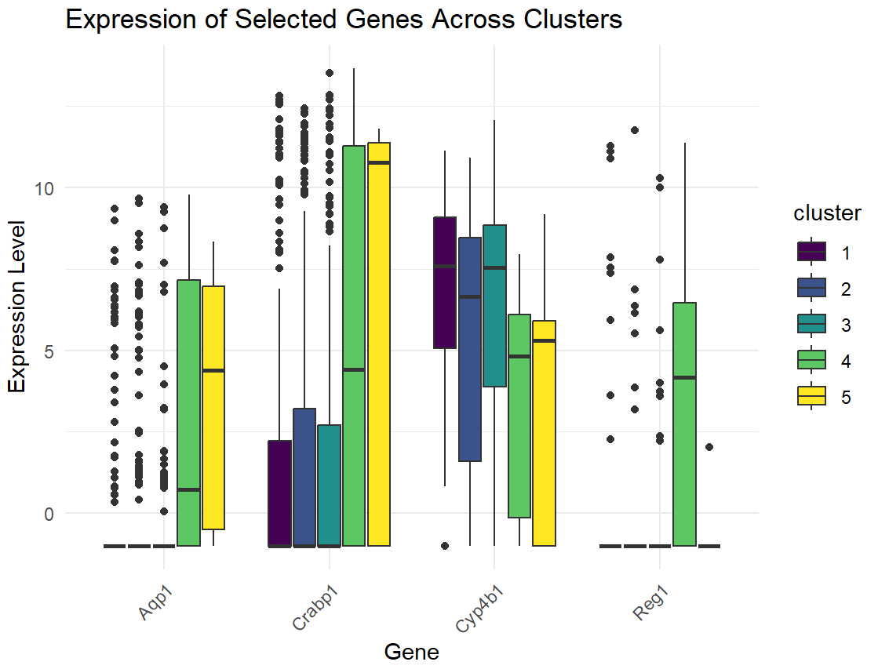
Significantly Differential Expressed Genes —— Results
total of 381 differentially expressed genes
up-regulation
Cluster 1 | Cluster 4 | Cluster 5
Cyp4b1 | Reg1 | Aqp1
down-regulation
Cluster 1
Crabp1
15

Slide 16
Discussion
Conclusion
GMM: assign the cells to 5 clusters using EM algorithm.
Significantly Differential Expressed Genes ：
Define total of 381 DEGs
185 up regulated
195 down regulated
EM: Selection of Initial Parameters
Same resulting parameters across different clusters;
Some cluster does not contain any elements;
During iteration, poor selection may result in NA values.
Significantly Differential Expressed Genes:
Expression data is sparse data
Already normalized

Slide 17
Thanks!
Team Lead: Shaolei Ma
Members: Peng Su; Yilei Yang; Zhuodiao Kuang

